Slide 1

An automated system to limit COVID-19 using
Facial Mask Detection in a smart city Network
Date : 08 April 2021
Kanumuri SumaVallika - 17wh1a0542
Praneetha Bhupathiraju - 17wh1a0551
Bathula Varshitha Veena -17wh1a0557
Internal Guide : K . Rajesh
Designation : Assistant Professor
Department of Computer Science and Engineering
BVRIT HYDERABAD College of Engineering for Women

Slide 2

Why Should I Study this course?
PROJECT INTRODUCTION
Examples
Domain:
AI/ML
Proposed System:
COVID-19 facial mask detection is an application which restricts the growth of COVID-19 by finding people who are not wearing masks in public places which are monitored with Closed-Circuit Television(CCTV) cameras. This would be useful tool to reduce the spread of communicable disease.
BVRIT HYDERABAD College of Engineering for Women

Slide 3
SYSTEM SPECIFICATIONS
Hardware:
Processor - Intel Core i5
Memory(RAM) - 8 GB
Storage – I TB
Software:
Os - windows 10
Google colab
Anaconda Prompt
BVRIT HYDERABAD College of Engineering for Women

Slide 4
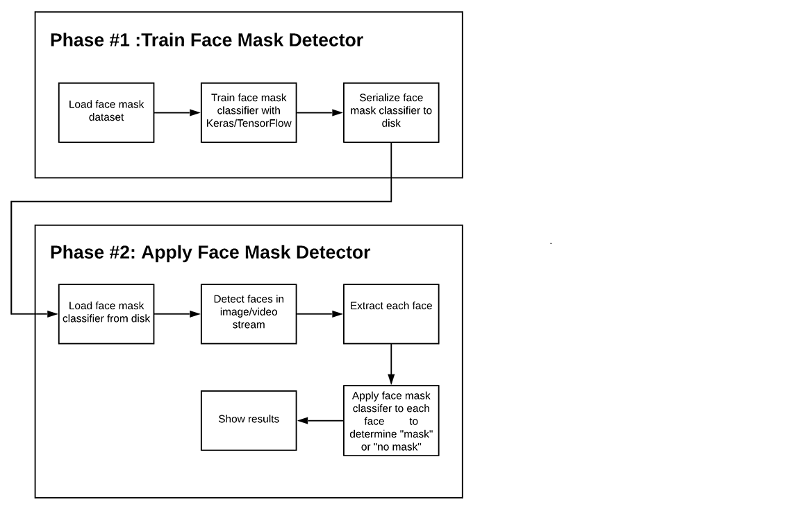
Flow Chart
BVRIT HYDERABAD College of Engineering for Women
BVRIT HYDERABAD College of Engineering for Women

Slide 5
References
Base paper:
https://ieeexplore.ieee.org/stamp/stamp.jsp?arnumber=9216386
https://www.nationalgeographic.com/science/article/face-mask-recognition-has-arrived-for-coronavirus-better-or-worse-cvd
https://www.irjet.net/archives/V7/i8/IRJET-V7I8530.pdf
Reference papers:
BVRIT HYDERABAD College of Engineering for Women

Slide 6
Thank you
BVRIT HYDERABAD College of Engineering for Women

